Slide 1
Chapter 2
Instructions: Language of the Computer
Notes:
The University of Adelaide, School of Computer Science
Chapter 2 — Instructions: Language of the Computer

Slide 2
Instruction Set
§2.1 Introduction
The repertoire of instructions of a computer
Different computers have different instruction sets
  But with many aspects in common
Early computers had very simple instruction sets
  Simplified implementation
Many modern computers also have simple instruction sets
Chapter 2 — Instructions: Language of the Computer — <number>
Notes:
The University of Adelaide, School of Computer Science
Chapter 2 — Instructions: Language of the Computer

Slide 3
Instruction Set Architecture
software
instruction set
hardware
One of the most important abstractions is ISA
  A critical interface between HW and SW
  Example: MIPS
Notes:
Contract between software and hardware

Slide 4

How does the pieces fit together
Application
Operating
System
Compiler
Firmware
Instruction Set
Architecture
Memory
system
Instr. Set Proc.
I/O system
Datapath & Control
Digital Design
Circuit Design
Chapter 2 — Instructions: Language of the Computer — <number>

Slide 5
The MIPS Instruction Set
Used as the example throughout the book
Stanford MIPS commercialized by MIPS Technologies (www.mips.com)
Large share of embedded core market
  Applications in consumer electronics, network/storage equipment, cameras, printers, …
Typical of many modern ISAs
  See MIPS Reference Data tear-out card, and Appendixes B and E
Chapter 2 — Instructions: Language of the Computer — <number>
Notes:
The University of Adelaide, School of Computer Science
Chapter 2 — Instructions: Language of the Computer

Slide 6
Arithmetic Operations
Add and subtract, three operands
  Two sources and one destination
add a, b, c # a gets b + c
All arithmetic operations have this form
§2.2 Operations of the Computer Hardware
Chapter 2 — Instructions: Language of the Computer — <number>
Notes:
The University of Adelaide, School of Computer Science
Chapter 2 — Instructions: Language of the Computer

Slide 7
Arithmetic Example
C code:
f = (g + h) - (i + j);
Compiled MIPS code:
add t0, g, h # temp t0 = g + h
add t1, i, j # temp t1 = i + j
sub f, t0, t1 # f = t0 - t1
Chapter 2 — Instructions: Language of the Computer — <number>
Notes:
The University of Adelaide, School of Computer Science
Chapter 2 — Instructions: Language of the Computer

Slide 8
Register Operands
Arithmetic instructions use register
operands
MIPS has a 32 × 32-bit register file
  Use for frequently accessed data
  Numbered 0 to 31
  32-bit data called a “word”
Assembler names
  $t0, $t1, …, $t9 for temporary values
  $s0, $s1, …, $s7 for saved variables
§2.3 Operands of the Computer Hardware
Chapter 2 — Instructions: Language of the Computer — <number>
Notes:
The University of Adelaide, School of Computer Science
Chapter 2 — Instructions: Language of the Computer

Slide 9
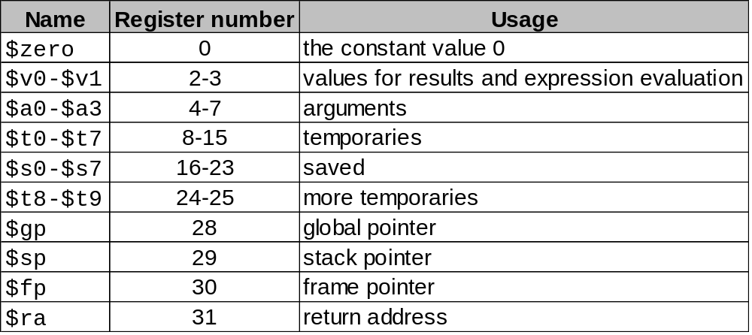
Register 1 ($at) reserved for assembler,
Registers 26-27 for operating system
Chapter 2 — Instructions: Language of the Computer — <number>

Slide 10
Register Operand Example
C code:
f = (g + h) - (i + j);
  f, …, j in $s0, …, $s4
Compiled MIPS code:
add $t0, $s1, $s2
add $t1, $s3, $s4
sub $s0, $t0, $t1
Chapter 2 — Instructions: Language of the Computer — <number>
Notes:
The University of Adelaide, School of Computer Science
Chapter 2 — Instructions: Language of the Computer

Slide 11
C code: A = B + C + D;
E = F - A;
MIPS code: add $t0, $s1, $s2
add $s0, $t0, $s3
sub $s4, $s5, $s0
What about programs with lots of variables?
Chapter 2 — Instructions: Language of the Computer — <number>

Slide 12
Memory Organization
Viewed as a large, single-dimension array, with an address.
A memory address is an index into the array
"Byte addressing" means that the index points to a byte of memory.
0
8 bits of data
1
8 bits of data
2
8 bits of data
3
8 bits of data
4
8 bits of data
5
8 bits of data
6
8 bits of data
...

Slide 13
Memory Operands
Main memory used for composite data
  Arrays, structures, dynamic data
To apply arithmetic operations
  Load values from memory into registers
  Store result from register to memory
Memory is byte addressed
  Each address identifies an 8-bit byte
Words are aligned in memory
  Address must be a multiple of 4
MIPS is Big Endian
  Most-significant byte at least address of a word
  c.f. Little Endian: least-significant byte at least address
Chapter 2 — Instructions: Language of the Computer — <number>
Notes:
The University of Adelaide, School of Computer Science
Chapter 2 — Instructions: Language of the Computer

Slide 14
Memory Operand Example 1
C code:
g = h + A[8];
  g in $s1, h in $s2, base address of A in $s3
Compiled MIPS code:
  Index 8 requires offset of 32
    4 bytes per word
lw $t0, 32($s3) # load word
add $s1, $s2, $t0
offset
base register
Chapter 2 — Instructions: Language of the Computer — <number>
Notes:
The University of Adelaide, School of Computer Science
Chapter 2 — Instructions: Language of the Computer

Slide 15
Memory Operand Example 2
C code:
A[12] = h + A[8];
  h in $s2, base address of A in $s3
Compiled MIPS code:
  Index 8 requires offset of 32
lw $t0, 32($s3) # load word
add $t0, $s2, $t0
sw $t0, 48($s3) # store word
Chapter 2 — Instructions: Language of the Computer — <number>
Notes:
The University of Adelaide, School of Computer Science
Chapter 2 — Instructions: Language of the Computer

Slide 16
Registers vs. Memory
Registers are faster to access than memory
Operating on memory data requires loads and stores
  More instructions to be executed
Compiler must use registers for variables as much as possible
  Only spill to memory for less frequently used variables
  Register optimization is important!
Chapter 2 — Instructions: Language of the Computer — <number>
Notes:
The University of Adelaide, School of Computer Science
Chapter 2 — Instructions: Language of the Computer

Slide 17
Immediate Operands
Constant data specified in an instruction
addi $s3, $s3, 4
No subtract immediate instruction
  Just use a negative constant
  addi $s2, $s1, -1
Design Principle : Make the common case fast
  Small constants are common
  Immediate operand avoids a load instruction
Chapter 2 — Instructions: Language of the Computer — <number>
Notes:
The University of Adelaide, School of Computer Science
Chapter 2 — Instructions: Language of the Computer

Slide 18
The Constant Zero
MIPS register 0 ($zero) is the constant 0
  Cannot be overwritten
Useful for common operations
  E.g., move between registers
  add $t2, $s1, $zero
Chapter 2 — Instructions: Language of the Computer — <number>
Notes:
The University of Adelaide, School of Computer Science
Chapter 2 — Instructions: Language of the Computer

Slide 19
MIPS R-format Instructions
op
rs
rt
rd
shamt
funct
6 bits
5 bits
5 bits
5 bits
5 bits
6 bits
Instruction fields
  op: operation code (opcode)
  rs: first source register number
  rt: second source register number
  rd: destination register number
  shamt: shift amount (00000 for now)
  funct: function code (extends opcode)
Chapter 2 — Instructions: Language of the Computer — <number>
Notes:
The University of Adelaide, School of Computer Science
Chapter 2 — Instructions: Language of the Computer

Slide 20
R-format Example
op
rs
rt
rd
shamt
funct
6 bits
5 bits
5 bits
5 bits
5 bits
6 bits
add $t0, $s1, $s2
special
$s1
$s2
$t0
0
add
0
17
18
8
0
32
000000
10001
10010
01000
00000
100000
00000010001100100100000000100000₂ = 02324020₁₆
Chapter 2 — Instructions: Language of the Computer — <number>
Notes:
The University of Adelaide, School of Computer Science
Chapter 2 — Instructions: Language of the Computer

Slide 21
MIPS I-format Instructions
op
rs
rt
constant or address
6 bits
5 bits
5 bits
16 bits
Immediate arithmetic and load/store instructions
  rt: destination or source register number
  Constant: –2¹⁵ to +2¹⁵ – 1
  Address: offset added to base address in rs
  Different formats complicate decoding, but allow 32-bit instructions uniformly
  Keep formats as similar as possible
  lw $t0,32($s3) |35|19|8|32|
Chapter 2 — Instructions: Language of the Computer — <number>
Notes:
The University of Adelaide, School of Computer Science
Chapter 2 — Instructions: Language of the Computer

Slide 22
So far we’ve learned: (p.59)
MIPS
— loading words but addressing bytes
— arithmetic on registers only
Instruction Meaning
add $s1, $s2, $s3 $s1 = $s2 + $s3
sub $s1, $s2, $s3 $s1 = $s2 – $s3
addi $s1, $s2,100 $s1 = $s2 + 100
lw $s1, 100($s2) $s1 = Memory[$s2+100]
sw $s1, 100($s2) Memory[$s2+100] = $s1

Slide 23
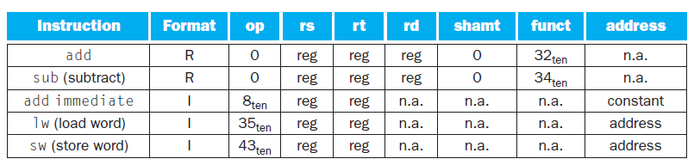
MIPS instruction encoding
Chapter 2 — Instructions: Language of the Computer — <number>

Slide 24
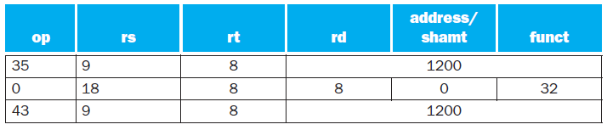
A[300] = h + A[300];
  is compiled to
lw $t0,1200($t1)
add $t0,$s2,$t0
sw $t0,1200($t1)
Chapter 2 — Instructions: Language of the Computer — <number>

Slide 25

Stored Program Computers
The BIG Picture
Instructions represented in binary, just like data
Instructions and data stored in memory
Programs can operate on programs
  e.g., compilers, linkers, …
Binary compatibility allows compiled programs to work on different computers
  Standardized ISAs
Chapter 2 — Instructions: Language of the Computer — <number>
Notes:
The University of Adelaide, School of Computer Science
Chapter 2 — Instructions: Language of the Computer

Slide 26
Stored Program Concept
Instructions are bits
Programs are stored in memory
— to be read or written just like data
Fetch & Execute Cycle
  Instructions are fetched and put into a special register
  Bits in the register "control" the subsequent actions
  Fetch the “next” instruction and continue

Slide 27
Logical Operations
Instructions for bitwise manipulation
§2.6 Logical Operations
Operation | C | Java | MIPS
Shift left | << | << | sll
Shift right | >> | >>> | srl
Bitwise AND | & | & | and, andi
Bitwise OR | | | | | or, ori
Bitwise NOT | ~ | ~ | nor
Useful for extracting and inserting groups of bits in a word
Chapter 2 — Instructions: Language of the Computer — <number>
Notes:
The University of Adelaide, School of Computer Science
Chapter 2 — Instructions: Language of the Computer

Slide 28
0000 0000 00000 000 0000 0000 0000 1001two= 9_{ten}
9<<4
0000 0000 0000 0000 0000 0000 1001 0000two= 144_{ten}
sll $t2,$s0,4
shamt: how many positions to shift
Chapter 2 — Instructions: Language of the Computer — <number>

Slide 29

Shift Operations
op
rs
rt
rd
shamt
funct
6 bits
5 bits
5 bits
5 bits
5 bits
6 bits
Shift left logical
  Shift left and fill with 0 bits
  sll by i bits multiplies by 2^{i}
Shift right logical
  Shift right and fill with 0 bits
  srl by i bits divides by 2^{i} (unsigned only)
Chapter 2 — Instructions: Language of the Computer — <number>
Notes:
The University of Adelaide, School of Computer Science
Chapter 2 — Instructions: Language of the Computer

Slide 30
AND Operations
Useful to mask bits in a word
  Select some bits, clear others to 0
and $t0, $t1, $t2
$t2
0000 0000 0000 0000 0000 1101 1100 0000
$t1
0000 0000 0000 0000 0011 1100 0000 0000
$t0
0000 0000 0000 0000 0000 1100 0000 0000
Chapter 2 — Instructions: Language of the Computer — <number>
Notes:
The University of Adelaide, School of Computer Science
Chapter 2 — Instructions: Language of the Computer

Slide 31
OR Operations
Useful to include bits in a word
  Set some bits to 1, leave others unchanged
or $t0, $t1, $t2
$t2
0000 0000 0000 0000 0000 1101 1100 0000
$t1
0000 0000 0000 0000 0011 1100 0000 0000
$t0
0000 0000 0000 0000 0011 1101 1100 0000
Chapter 2 — Instructions: Language of the Computer — <number>
Notes:
The University of Adelaide, School of Computer Science
Chapter 2 — Instructions: Language of the Computer

Slide 32
NOT Operations
Useful to invert bits in a word
  Change 0 to 1, and 1 to 0
MIPS has NOR 3-operand instruction
  a NOR b == NOT ( a OR b )
nor $t0, $t1, $zero
Register 0: always read as zero
$t1
0000 0000 0000 0000 0011 1100 0000 0000
$t0
1111 1111 1111 1111 1100 0011 1111 1111
Chapter 2 — Instructions: Language of the Computer — <number>
Notes:
The University of Adelaide, School of Computer Science
Chapter 2 — Instructions: Language of the Computer

Slide 33
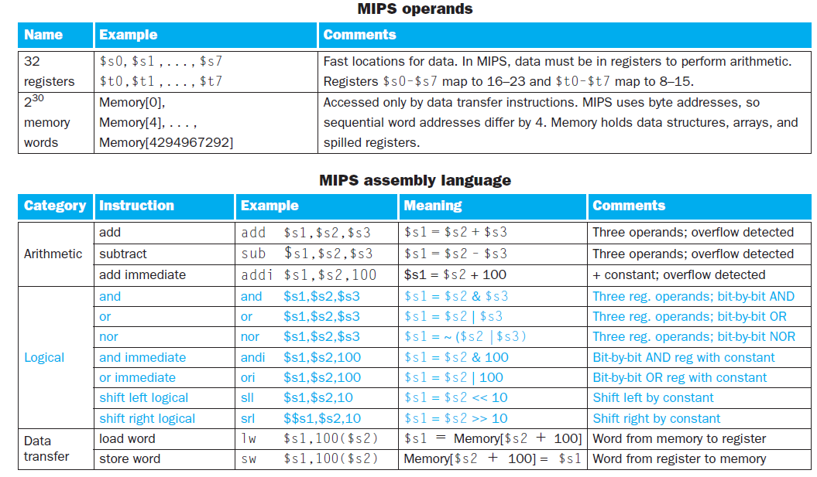
Chapter 2 — Instructions: Language of the Computer — <number>

Slide 34
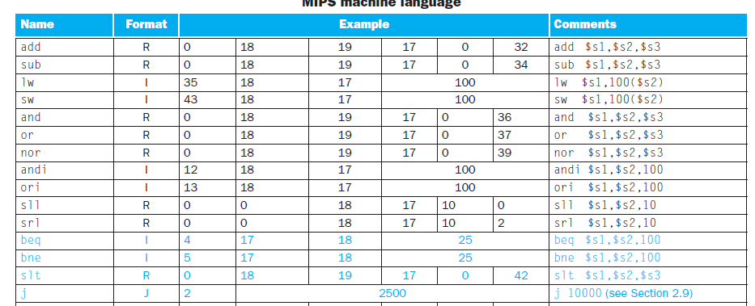
MIPS machine language
Chapter 2 — Instructions: Language of the Computer — <number>

Slide 35
Conditional Operations
Branch to a labeled instruction if a condition is true
  Otherwise, continue sequentially
beq rs, rt, L1
  if (rs == rt) branch to instruction labeled L1;
bne rs, rt, L1
  if (rs != rt) branch to instruction labeled L1;
j L1
  unconditional jump to instruction labeled L1
§2.7 Instructions for Making Decisions
Chapter 2 — Instructions: Language of the Computer — <number>
Notes:
The University of Adelaide, School of Computer Science
Chapter 2 — Instructions: Language of the Computer

Slide 36

Compiling If Statements
C code:
if (i==j) f = g+h;
else f = g-h;
  f, g, … in $s0, $s1, …
Compiled MIPS code:
bne $s3, $s4, Else
add $s0, $s1, $s2
j Exit
Else: sub $s0, $s1, $s2
Exit: …
Assembler calculates addresses
Chapter 2 — Instructions: Language of the Computer — <number>
Notes:
The University of Adelaide, School of Computer Science
Chapter 2 — Instructions: Language of the Computer

Slide 37
Compiling Loop Statements
C code:
while (save[i] == k) i += 1;
  i in $s3, k in $s5, address of save in $s6
Compiled MIPS code: ???
Chapter 2 — Instructions: Language of the Computer — <number>
Notes:
The University of Adelaide, School of Computer Science
Chapter 2 — Instructions: Language of the Computer

Slide 38
Compiling Loop Statements
C code:
while (save[i] == k) i += 1;
  i in $s3, k in $s5, address of save in $s6
Compiled MIPS code:
Loop: sll $t1, $s3, 2
add $t1, $t1, $s6
lw $t0, 0($t1)
bne $t0, $s5, Exit
addi $s3, $s3, 1
j Loop
Exit: …
Chapter 2 — Instructions: Language of the Computer — <number>
Notes:
The University of Adelaide, School of Computer Science
Chapter 2 — Instructions: Language of the Computer

Slide 39
More Conditional Operations
Set result to 1 if a condition is true
  Otherwise, set to 0
slt rd, rs, rt
  if (rs < rt) rd = 1; else rd = 0;
slti rt, rs, constant
  if (rs < constant) rt = 1; else rt = 0;
Use in combination with beq, bne
  slt $t0, $s1, $s2 # if ($s1 < $s2)
  bne $t0, $zero, L # branch to L
Chapter 2 — Instructions: Language of the Computer — <number>
Notes:
The University of Adelaide, School of Computer Science
Chapter 2 — Instructions: Language of the Computer

Slide 40
Branch Instruction Design
Why not blt, bge, etc?
Hardware for <, ≥, … slower than =, ≠
  Combining with branch involves more work per instruction, requiring a slower clock
  All instructions penalized!
beq and bne are the common case
This is a good design compromise
Chapter 2 — Instructions: Language of the Computer — <number>
Notes:
The University of Adelaide, School of Computer Science
Chapter 2 — Instructions: Language of the Computer

Slide 41
Signed vs. Unsigned
Signed comparison: slt
Unsigned comparison: sltu
Example
  $s0 = 1111 1111 1111 1111 1111 1111 1111 1111
  $s1 = 0000 0000 0000 0000 0000 0000 0000 0001
  slt $t0, $s0, $s1 # signed
    ????
  sltu $t0, $s0, $s1 # unsigned
    ????
Chapter 2 — Instructions: Language of the Computer — <number>
Notes:
The University of Adelaide, School of Computer Science
Chapter 2 — Instructions: Language of the Computer

Slide 42
Signed vs. Unsigned
Signed comparison: slt
Unsigned comparison: sltu
Example
  $s0 = 1111 1111 1111 1111 1111 1111 1111 1111
  $s1 = 0000 0000 0000 0000 0000 0000 0000 0001
  slt $t0, $s0, $s1 # signed
    –1 < +1 ⇒ $t0 = 1
  sltu $t0, $s0, $s1 # unsigned
    +4,294,967,295 > +1 ⇒ $t0 = 0
Chapter 2 — Instructions: Language of the Computer — <number>
Notes:
The University of Adelaide, School of Computer Science
Chapter 2 — Instructions: Language of the Computer

Slide 43
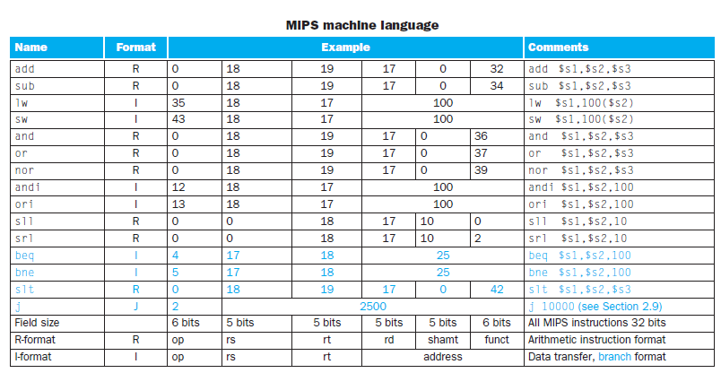
Opcode for instructions
Chapter 2 — Instructions: Language of the Computer — <number>

Slide 44
Procedures
A stored sub-program that performs a specific task based on the parameters with which it is provided
  It makes the code understandable and allowed the code to be reused.
  The coder can concentrate on just one portion of task at time, with parameters acting as a barrier
    Passed values and return values
Chapter 2 — Instructions: Language of the Computer — <number>

Slide 45
Procedure Calling
In the execution of the procedure, the program must follow these six steps
    Place parameters in registers
    Transfer control to procedure
    Acquire storage for procedure
    Perform procedure’s operations
    Place result in register for caller
    Return to place of call
§2.8 Supporting Procedures in Computer Hardware
Chapter 2 — Instructions: Language of the Computer — <number>
Notes:
The University of Adelaide, School of Computer Science
Chapter 2 — Instructions: Language of the Computer

Slide 46
Register Usage
$a0 – $a3: arguments (reg’s 4 – 7)
$v0, $v1: result values (reg’s 2 and 3)
$t0 – $t9: temporaries
  Can be overwritten by callee
$s0 – $s7: saved
  Must be saved/restored by callee
$gp: global pointer for static data (reg 28)
$sp: stack pointer (reg 29)
$fp: frame pointer (reg 30)
$ra: return address (reg 31)
Chapter 2 — Instructions: Language of the Computer — <number>
Notes:
The University of Adelaide, School of Computer Science
Chapter 2 — Instructions: Language of the Computer

Slide 47
Procedure Call Instructions
Procedure call: jump and link
jal ProcedureLabel
  Address of following instruction put in $ra
  Jumps to target address
Procedure return: jump register
jr $ra
  Copies $ra to program counter
  Can also be used for computed jumps
    e.g., for case/switch statements
Chapter 2 — Instructions: Language of the Computer — <number>
Notes:
The University of Adelaide, School of Computer Science
Chapter 2 — Instructions: Language of the Computer

Slide 48
Leaf Procedure Example
C code:
int leaf_example (int g, h, i, j)
{ int f;
f = (g + h) - (i + j);
return f;
}
  Arguments g, …, j in $a0, …, $a3
  f in $s0 (hence, need to save $s0 on stack)
  Result in $v0
Chapter 2 — Instructions: Language of the Computer — <number>
Notes:
The University of Adelaide, School of Computer Science
Chapter 2 — Instructions: Language of the Computer

Slide 49
Leaf Procedure Example
MIPS code:
leaf_example:
addi $sp, $sp, -4
sw $s0, 0($sp)
add $t0, $a0, $a1
add $t1, $a2, $a3
sub $s0, $t0, $t1
add $v0, $s0, $zero
lw $s0, 0($sp)
addi $sp, $sp, 4
jr $ra
Save $s0 on stack
Procedure body
Result
Restore $s0
Return
Chapter 2 — Instructions: Language of the Computer — <number>
Notes:
The University of Adelaide, School of Computer Science
Chapter 2 — Instructions: Language of the Computer

Slide 50
Non-Leaf Procedures
Procedures that call other procedures
For nested call, caller needs to save on the stack:
  Its return address
  Any arguments and temporaries needed after the call
Restore from the stack after the call
Chapter 2 — Instructions: Language of the Computer — <number>
Notes:
The University of Adelaide, School of Computer Science
Chapter 2 — Instructions: Language of the Computer

Slide 51
Non-Leaf Procedure Example
C code:
int fact (int n)
{
if (n < 1) return 1;
else return n * fact(n - 1);
}
  Argument n in $a0
  Result in $v0
Chapter 2 — Instructions: Language of the Computer — <number>
Notes:
The University of Adelaide, School of Computer Science
Chapter 2 — Instructions: Language of the Computer

Slide 52
Non-Leaf Procedure Example
MIPS code:
fact:
addi $sp, $sp, -8 # adjust stack for 2 items
sw $ra, 4($sp) # save return address
sw $a0, 0($sp) # save argument
slti $t0, $a0, 1 # test for n < 1
beq $t0, $zero, L1
addi $v0, $zero, 1 # if so, result is 1
addi $sp, $sp, 8 # pop 2 items from stack
jr $ra # and return
L1: addi $a0, $a0, -1 # else decrement n
jal fact # recursive call
lw $a0, 0($sp) # restore original n
lw $ra, 4($sp) # and return address
addi $sp, $sp, 8 # pop 2 items from stack
mul $v0, $a0, $v0 # multiply to get result
jr $ra # and return
Chapter 2 — Instructions: Language of the Computer — <number>
Notes:
The University of Adelaide, School of Computer Science
Chapter 2 — Instructions: Language of the Computer

Slide 53
Stack frame – activation record
The final complexity of stack is to store variables that are local to the procedure that donot fit in registers (eg, arrays etc)
Stack segment which contains saved registers and local variables is called activation record
MIPS uses frame pointer ($fp) to point to the first word of the frame. And stack pointer is used to point the variables and registers inside a frame.
Chapter 2 — Instructions: Language of the Computer — <number>

Slide 54

Local Data on the Stack
Local data allocated by callee
  e.g., C automatic variables
Procedure frame (activation record)
  Used by some compilers to manage stack storage
Chapter 2 — Instructions: Language of the Computer — <number>
Notes:
The University of Adelaide, School of Computer Science
Chapter 2 — Instructions: Language of the Computer

Slide 55

Memory Layout
Text: program code
Static data: global variables
  e.g., static variables in C, constant arrays and strings
  $gp initialized to address allowing ±offsets into this segment
Dynamic data: heap
  E.g., malloc in C, new in Java
Stack: automatic storage
Memory leak, dangling pointers
Chapter 2 — Instructions: Language of the Computer — <number>
Notes:
The University of Adelaide, School of Computer Science
Chapter 2 — Instructions: Language of the Computer

Slide 56
Character Data
Byte-encoded character sets
  ASCII: 128 characters
    95 graphic, 33 control
  Latin-1: 256 characters
    ASCII, +96 more graphic characters
§2.9 Communicating with People
Chapter 2 — Instructions: Language of the Computer — <number>
Notes:
The University of Adelaide, School of Computer Science
Chapter 2 — Instructions: Language of the Computer

Slide 57
Byte/Halfword Operations
Could use bitwise operations
MIPS byte/halfword load/store
  String processing is a common case
lb rt, offset(rs) lh rt, offset(rs)
  Sign extend to 32 bits in rt
sb rt, offset(rs) sh rt, offset(rs)
  Store just rightmost byte/halfword
Chapter 2 — Instructions: Language of the Computer — <number>
Notes:
The University of Adelaide, School of Computer Science
Chapter 2 — Instructions: Language of the Computer

Slide 58
strings
Characters are normally combined to strings, which have variable no of chars
To represent a string, 3 methods are
  First position of string is reserved to give the length
  Accompanying variable will have length value
  The last position of string – end indicator.
  Eg “Cal” – 67, 97,108,0
Chapter 2 — Instructions: Language of the Computer — <number>

Slide 59
String Copy Example
C code (naïve):
  Null-terminated string
void strcpy (char x[], char y[])
{ int i;
i = 0;
while ((x[i]=y[i])!='\0')
i += 1;
}
  Addresses of x, y in $a0, $a1
  i in $s0
Chapter 2 — Instructions: Language of the Computer — <number>
Notes:
The University of Adelaide, School of Computer Science
Chapter 2 — Instructions: Language of the Computer

Slide 60
String Copy Example
MIPS code:
strcpy:
addi $sp, $sp, -4 # adjust stack for 1 item
sw $s0, 0($sp) # save $s0
add $s0, $zero, $zero # i = 0
L1: add $t1, $s0, $a1 # addr of y[i] in $t1
lb $t2, 0($t1) # $t2 = y[i]
add $t3, $s0, $a0 # addr of x[i] in $t3
sb $t2, 0($t3) # x[i] = y[i]
beq $t2, $zero, L2 # exit loop if y[i] == 0
addi $s0, $s0, 1 # i = i + 1
j L1 # next iteration of loop
L2: lw $s0, 0($sp) # restore saved $s0
addi $sp, $sp, 4 # pop 1 item from stack
jr $ra # and return
Chapter 2 — Instructions: Language of the Computer — <number>
Notes:
The University of Adelaide, School of Computer Science
Chapter 2 — Instructions: Language of the Computer

Slide 61
Half words
To load and store 16 bit quanities (half word) MIPS provides you
  lh – loads half word from memory, placing it in the right most 16 bits of the register
  sh – reverse operation
Chapter 2 — Instructions: Language of the Computer — <number>

Slide 62
32-bit Constants
Most constants are small
  16-bit immediate is sufficient
For the occasional 32-bit constant
lui rt, constant
  Copies 16-bit constant to left 16 bits of rt
  Clears right 16 bits of rt to 0
§2.10 MIPS Addressing for 32-Bit Immediates and Addresses
lui $s0, 61
0000 0000 0111 1101 0000 0000 0000 0000
ori $s0, $s0, 2304
0000 0000 0111 1101 0000 1001 0000 0000
Chapter 2 — Instructions: Language of the Computer — <number>
Notes:
The University of Adelaide, School of Computer Science
Chapter 2 — Instructions: Language of the Computer

Slide 63
Branch Addressing
Branch instructions specify
  Opcode, two registers, target address
Most branch targets are near branch
  Forward or backward
op
rs
rt
constant or address
6 bits
5 bits
5 bits
16 bits
PC-relative addressing
  Target address = PC + offset × 4
  PC already incremented by 4 by this time
Chapter 2 — Instructions: Language of the Computer — <number>
Notes:
The University of Adelaide, School of Computer Science
Chapter 2 — Instructions: Language of the Computer

Slide 64
Jump Addressing
Jump (j and jal) targets could be anywhere in text segment
  Encode full address in instruction
op
address
6 bits
26 bits
(Pseudo)Direct jump addressing
  Target address = PC_{31…28} : (address × 4)
Chapter 2 — Instructions: Language of the Computer — <number>
Notes:
The University of Adelaide, School of Computer Science
Chapter 2 — Instructions: Language of the Computer

Slide 65
Branching Far Away
If branch target is too far to encode with 16-bit offset, assembler rewrites the code
Example
  beq $s0,$s1, L1
  ↓
  L1: bne $s0,$s1, L2
  j L1
  L2: …
Chapter 2 — Instructions: Language of the Computer — <number>
Notes:
The University of Adelaide, School of Computer Science
Chapter 2 — Instructions: Language of the Computer

Slide 66

Addressing Mode Summary
Chapter 2 — Instructions: Language of the Computer — <number>
Notes:
The University of Adelaide, School of Computer Science
Chapter 2 — Instructions: Language of the Computer

Slide 67
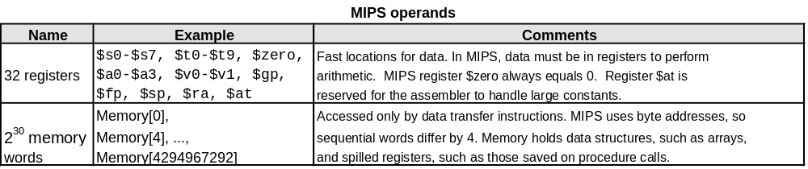
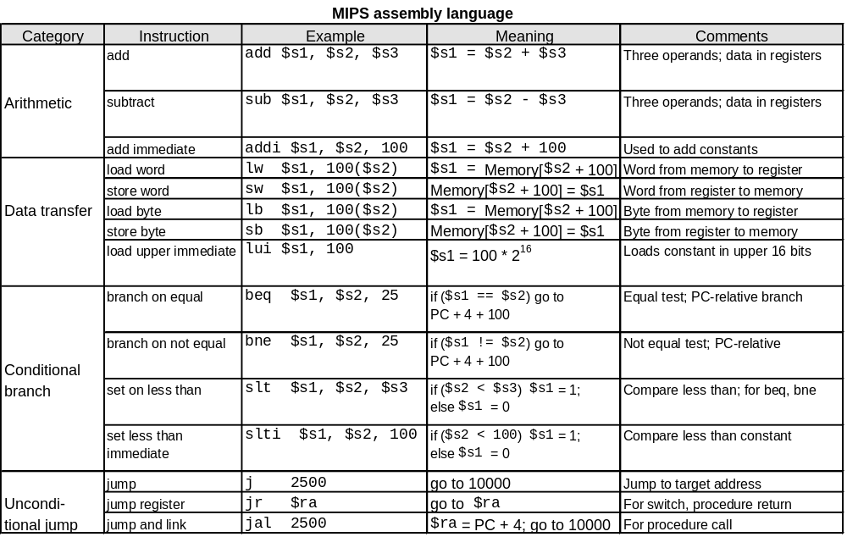
To summarize:

Slide 68
Arrays & Pointers in MIPS
Chapter 2 — Instructions: Language of the Computer — <number>

Slide 69
C Sort Example
Swap procedure (leaf)
  void swap(int v[], int k)
  {
  int temp;
  temp = v[k];
  v[k] = v[k+1];
  v[k+1] = temp;
  }
  v in $a0, k in $a1, temp in $t0
§2.13 A C Sort Example to Put It All Together
Chapter 2 — Instructions: Language of the Computer — <number>
Notes:
The University of Adelaide, School of Computer Science
Chapter 2 — Instructions: Language of the Computer

Slide 70
The Procedure Swap
swap: sll $t1, $a1, 2 # $t1 = k * 4
add $t1, $a0, $t1 # $t1 = v+(k*4)
# (address of v[k])
lw $t0, 0($t1) # $t0 (temp) = v[k]
lw $t2, 4($t1) # $t2 = v[k+1]
sw $t2, 0($t1) # v[k] = $t2 (v[k+1])
sw $t0, 4($t1) # v[k+1] = $t0 (temp)
jr $ra # return to calling routine
Chapter 2 — Instructions: Language of the Computer — <number>
Notes:
The University of Adelaide, School of Computer Science
Chapter 2 — Instructions: Language of the Computer

Slide 71
The Sort Procedure in C
bubble sort function
Non-leaf (calls swap)
  void sort (int v[], int n)
  {
  int i, j;
  for (i = 0; i < n; i += 1) {
  for (j = i – 1;
  j >= 0 && v[j] > v[j + 1];
  j -= 1) {
  swap(v,j);
  }
  }
  }
  v in $a0, k in $a1, i in $s0, j in $s1
Chapter 2 — Instructions: Language of the Computer — <number>
Notes:
The University of Adelaide, School of Computer Science
Chapter 2 — Instructions: Language of the Computer

Slide 72
C Sort Example
Swap procedure (leaf)
  void swap(int v[], int k)
  {
  int temp;
  temp = v[k];
  v[k] = v[k+1];
  v[k+1] = temp;
  }
  v in $a0, k in $a1, temp in $t0
§2.13 A C Sort Example to Put It All Together
Chapter 2 — Instructions: Language of the Computer — <number>
Notes:
The University of Adelaide, School of Computer Science
Chapter 2 — Instructions: Language of the Computer

Slide 73
The Procedure Swap
swap: sll $t1, $a1, 2 # $t1 = k * 4
add $t1, $a0, $t1 # $t1 = v+(k*4)
# (address of v[k])
lw $t0, 0($t1) # $t0 (temp) = v[k]
lw $t2, 4($t1) # $t2 = v[k+1]
sw $t2, 0($t1) # v[k] = $t2 (v[k+1])
sw $t0, 4($t1) # v[k+1] = $t0 (temp)
jr $ra # return to calling routine
Chapter 2 — Instructions: Language of the Computer — <number>
Notes:
The University of Adelaide, School of Computer Science
Chapter 2 — Instructions: Language of the Computer

Slide 74
The Sort Procedure in C
Non-leaf (calls swap)
  void sort (int v[], int n)
  {
  int i, j;
  for (i = 0; i < n; i += 1) {
  for (j = i – 1;
  j >= 0 && v[j] > v[j + 1];
  j -= 1) {
  swap(v,j);
  }
  }
  }
  v in $a0, n in $a1, i in $s0, j in $s1
Chapter 2 — Instructions: Language of the Computer — <number>
Notes:
The University of Adelaide, School of Computer Science
Chapter 2 — Instructions: Language of the Computer

Slide 75
The Procedure Body
move $s2, $a0 # save $a0 into $s2
move $s3, $a1 # save $a1 into $s3
move $s0, $zero # i = 0
for1tst: slt $t0, $s0, $s3 # $t0 = 0 if $s0 ≥ $s3 (i ≥ n)
beq $t0, $zero, exit1 # go to exit1 if $s0 ≥ $s3 (i ≥ n)
addi $s1, $s0, –1 # j = i – 1
for2tst: slti $t0, $s1, 0 # $t0 = 1 if $s1 < 0 (j < 0)
bne $t0, $zero, exit2 # go to exit2 if $s1 < 0 (j < 0)
sll $t1, $s1, 2 # $t1 = j * 4
add $t2, $s2, $t1 # $t2 = v + (j * 4)
lw $t3, 0($t2) # $t3 = v[j]
lw $t4, 4($t2) # $t4 = v[j + 1]
slt $t0, $t4, $t3 # $t0 = 0 if $t4 ≥ $t3
beq $t0, $zero, exit2 # go to exit2 if $t4 ≥ $t3
move $a0, $s2 # 1st param of swap is v (old $a0)
move $a1, $s1 # 2nd param of swap is j
jal swap # call swap procedure
addi $s1, $s1, –1 # j –= 1
j for2tst # jump to test of inner loop
exit2: addi $s0, $s0, 1 # i += 1
j for1tst # jump to test of outer loop
Move
params
Outer loop
Inner loop
Pass
params
& call
Inner loop
Outer loop
Chapter 2 — Instructions: Language of the Computer — <number>
Notes:
The University of Adelaide, School of Computer Science
Chapter 2 — Instructions: Language of the Computer

Slide 76
The Full Procedure
sort: addi $sp,$sp, –20 # make room on stack for 5 registers
sw $ra, 16($sp) # save $ra on stack
sw $s3,12($sp) # save $s3 on stack
sw $s2, 8($sp) # save $s2 on stack
sw $s1, 4($sp) # save $s1 on stack
sw $s0, 0($sp) # save $s0 on stack
… # procedure body
…
exit1: lw $s0, 0($sp) # restore $s0 from stack
lw $s1, 4($sp) # restore $s1 from stack
lw $s2, 8($sp) # restore $s2 from stack
lw $s3,12($sp) # restore $s3 from stack
lw $ra,16($sp) # restore $ra from stack
addi $sp,$sp, 20 # restore stack pointer
jr $ra # return to calling routine
Chapter 2 — Instructions: Language of the Computer — <number>
Notes:
The University of Adelaide, School of Computer Science
Chapter 2 — Instructions: Language of the Computer

Slide 77
Arrays vs. Pointers
Array indexing involves
  Multiplying index by element size
  Adding to array base address
Pointers correspond directly to memory addresses
  Can avoid indexing complexity
§2.14 Arrays versus Pointers
Chapter 2 — Instructions: Language of the Computer — <number>
Notes:
The University of Adelaide, School of Computer Science
Chapter 2 — Instructions: Language of the Computer

Slide 78
Example: Clearing and Array
clear1(int array[], int size) { int i; for (i = 0; i < size; i += 1) array[i] = 0; } | clear2(int *array, int size) { int *p; for (p = &array[0]; p < &array[size]; p = p + 1) *p = 0; }
move $t0,$zero # i = 0 loop1: sll $t1,$t0,2 # $t1 = i * 4 add $t2,$a0,$t1 # $t2 = # &array[i] sw $zero, 0($t2) # array[i] = 0 addi $t0,$t0,1 # i = i + 1 slt $t3,$t0,$a1 # $t3 = # (i < size) bne $t3,$zero,loop1 # if (…) # goto loop1 | move $t0,$a0 # p = & array[0] sll $t1,$a1,2 # $t1 = size * 4 add $t2,$a0,$t1 # $t2 = # &array[size] loop2: sw $zero,0($t0) # Memory[p] = 0 addi $t0,$t0,4 # p = p + 4 slt $t3,$t0,$t2 # $t3 = #(p<&array[size]) bne $t3,$zero,loop2 # if (…) # goto loop2
Chapter 2 — Instructions: Language of the Computer — <number>
Notes:
The University of Adelaide, School of Computer Science
Chapter 2 — Instructions: Language of the Computer

Slide 79
Concluding Remarks
Measure MIPS instruction
Instruction class | MIPS examples
Arithmetic | add, sub, addi
Data transfer | lw, sw, lb, lbu, lh, lhu, sb, lui
Logical | and, or, nor, andi, ori, sll, srl
Cond. Branch | beq, bne, slt, slti, sltiu
Jump | j, jr, jal
Chapter 2 — Instructions: Language of the Computer — <number>
Notes:
The University of Adelaide, School of Computer Science
Chapter 2 — Instructions: Language of the Computer

